Slide 1
Memory Management In Java
Understanding the JVM Memory Model
- Shridhar Pandey

Slide 2
Introduction to Memory Management
Definition
Memory management involves allocating and deallocating memory to applications.
Importance
Efficient memory management is crucial for application performance and stability.
Java’s Approach
Java handles memory management through the Java Virtual Machine (JVM).

Slide 3
Java Memory Model
Components
Heap Memory
Stores objects and class instances.
Stack Memory
Stores method calls and local variables.
Method Area
Stores class structure and static variables.
Program Counter (PC) Register
Keeps track of the current instruction.
Native Method Stack (C Stack)
Manages native method calls.

Slide 4
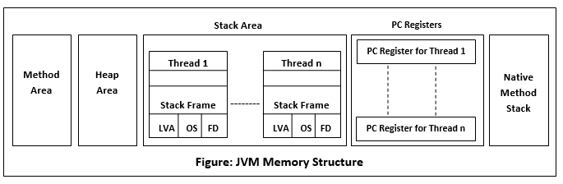

Slide 5
Heap Memory Structure
Eden Space
Where new objects are allocated.
Survivor Spaces (S0 and S1)
Used for copying objects during garbage collection.
Old Generation (Tenured)
Stores long-lived objects.
Permanent Generation (Metaspace in Java 8+)
Stores class metadata.

Slide 6
Stack Memory
Structure
Organized in frames for each method call.
Contents
Local variables, method parameters, return addresses.
Lifespan
Exists only during the execution of the method.

Slide 7
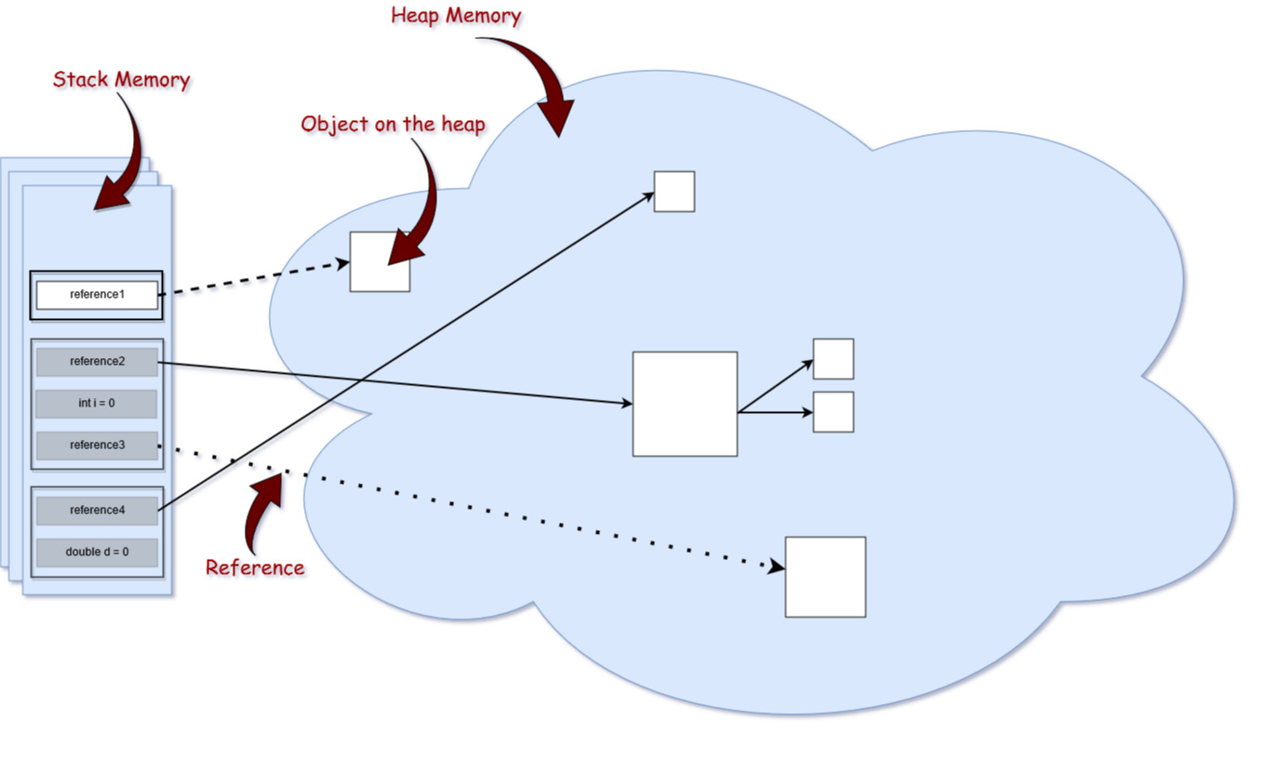

Slide 8
Garbage Collection
Definition
The process of automatically freeing memory by destroying unreachable objects
Runtime.gc() and System.gc() methods can be used to request the JVM to collect the garbage (not recommended). But the manual invocation is not guaranteed by the JVM.
Types of Garbage Collectors
Serial Garbage Collector
Uses a single thread.
Parallel Garbage Collector
Uses multiple threads.
Concurrent Mark-Sweep (CMS) Collector
Focuses on low latency.
Garbage First (G1) Collector
Balances between throughput and latency.

Slide 9
Garbage Collection Phases
Mark Phase
Identifies live objects.
Sweep Phase
Deletes unreachable objects.
Compact Phase
Reduces fragmentation by moving objects.

Slide 10
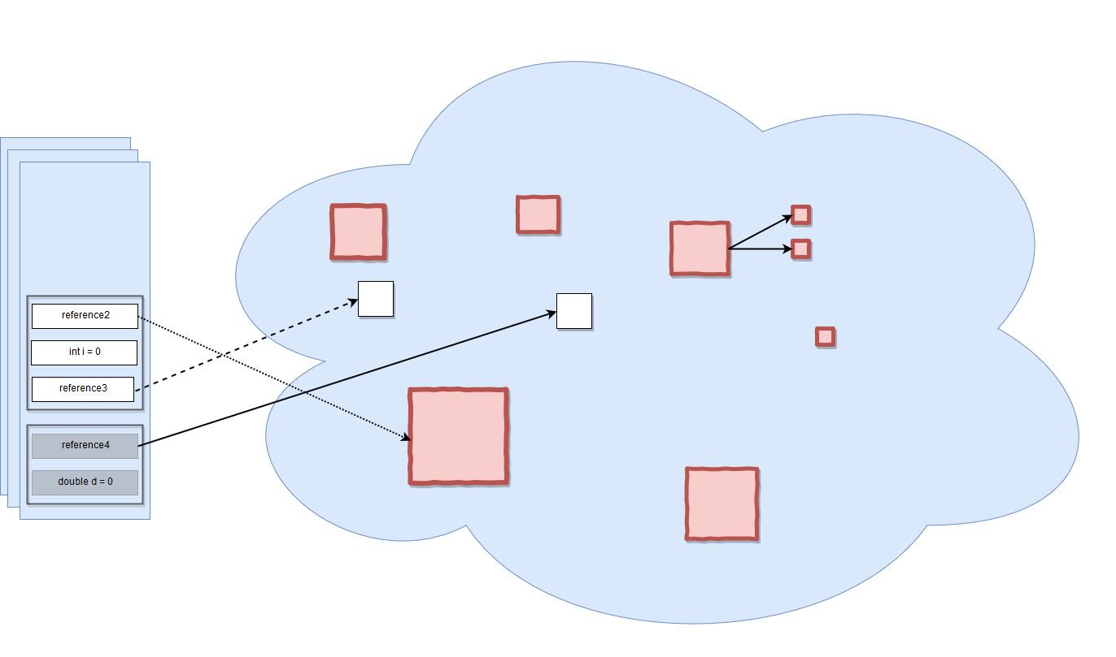

Slide 11
Generational Garbage Collection
Young Generation (Collected by Minor GC: Mark, Copy & Sweep)
Frequently collects short-lived objects, causes a short pause.
Old Generation (Collected by Major GC: Mark, Sweep & Compact)
Collects long-lived objects less frequently, causes longer pause.
Entire Heap (Collected by Full GC : Mark, Sweep & Compact)
Collects entire heap memory under specific conditions, causes longest pause.
Advantages
Improves efficiency by focusing on objects' lifespan

Slide 12
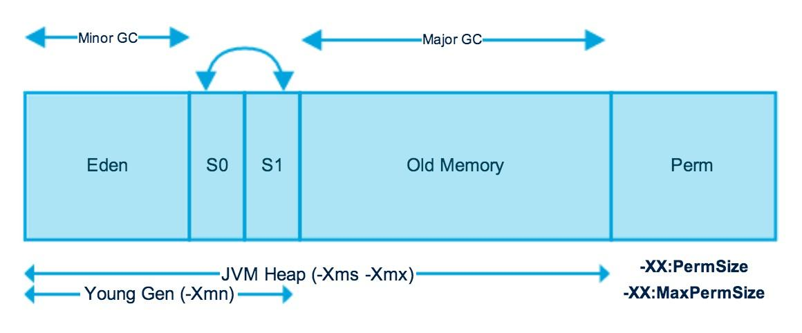

Slide 13
Tuning Garbage Collection
Heap Size
Adjust initial (-Xms) and maximum (-Xmx) heap size.
GC Algorithms
Choose based on application needs.
Monitoring Tools
Use tools like JVisualVM and GC logs for analysis.

Slide 14
Best Practices for Memory Management
Avoid Memory Leaks
Properly close resources like streams and connections.
Use Efficient Data Structures
Choose appropriate collections.
Optimize Object Creation
Reuse objects when possible.
Profile and Monitor
Regularly check memory usage and performance.

Slide 15
Conclusion
Summary
Java's automatic memory management simplifies development but requires understanding and tuning for optimal performance.
Knowing how memory is organized gives you the advantage of writing good and optimized code in terms of memory resources.
Final Thoughts
Effective memory management ensures application reliability and efficiency.

Slide 16
Thank You So Much!
Under the guidance of Rohit Sir and Indrakka Mam
(Edubridge * Capgemini)
Lots of Respect (Love) from Shridhar Pandey (Shri💓)

